Slide 1

THE LATEST BREAKTHROUGH EXPLAINED
Sentimental analysis:
using amazon reviews
By Team Number 3

Slide 2

outline
Introduction
2.About
3.Examples
4. Application
5.Implementation
6.Advantages
7.output samples
Send it to us! We hope you learned something new.

Slide 3
Introduction to Sentimental analysis
Sentiment analysis tries to uncover emotions in the text. By analyzing movie reviews, customer feedback, support tickets, companies may discover many interesting things. So learning how to build sentiment analysis models is quite a practical skill.
For the accurate classification of sentiments, many researchers have made efforts to combine deep learning and machine learning concepts in recent years. This section briefly describes the numerous studies related to sentiment analysis of web contents about users' opinions, emotions, reviews toward different matters and products using deep learning techniques

Slide 4

What is sentimental analysis
Sentiments are feelings, opinions, emotions, like/dislikes, good/bad
Sentiment Analysis is a Natural Languages Processing and Information Extraction task that aims to obtain writer's feelings expressed in positive or negative comments, questions and requests, by analyzing a large numbers of documents.
Sentiment Analysis is a study of human behavior in which we extract user opinion and emotion from plain data or text
Sentiment Analysis is also known as Opinion Mining

Slide 5

example
users opinion
Person 1: It's a good product. (Positive Statement)
Person 2: Nah! I didn't like it at all. (Negative Statement)
Person 3: The new Infinity T-shirt is awesome! (Positive statement
Polarity:
Positive
Negative
Complex

Slide 6

Application
Business and Organization
Brand Analysis
New Product perception
Product & Service benchmark
Individuals
Purchasing a product or using a service
Finding best option in sports, movies, etc

Slide 7
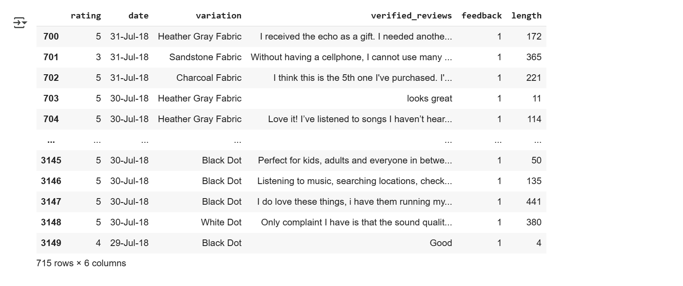
Relevant dataset

Slide 8
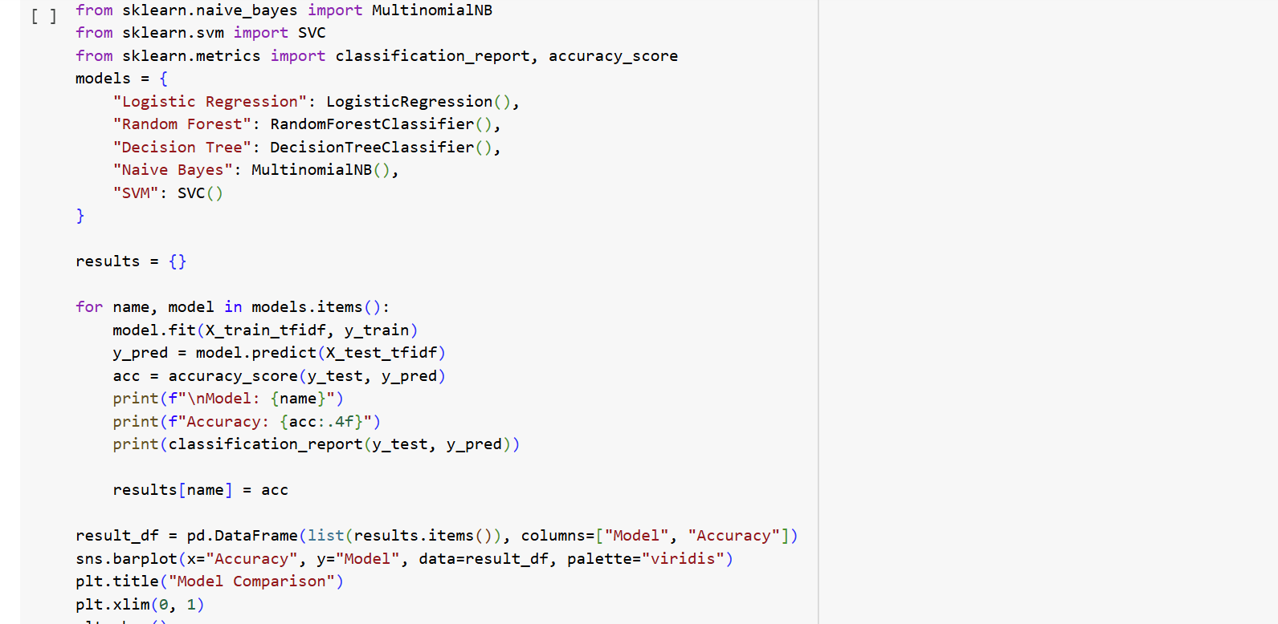

Slide 9
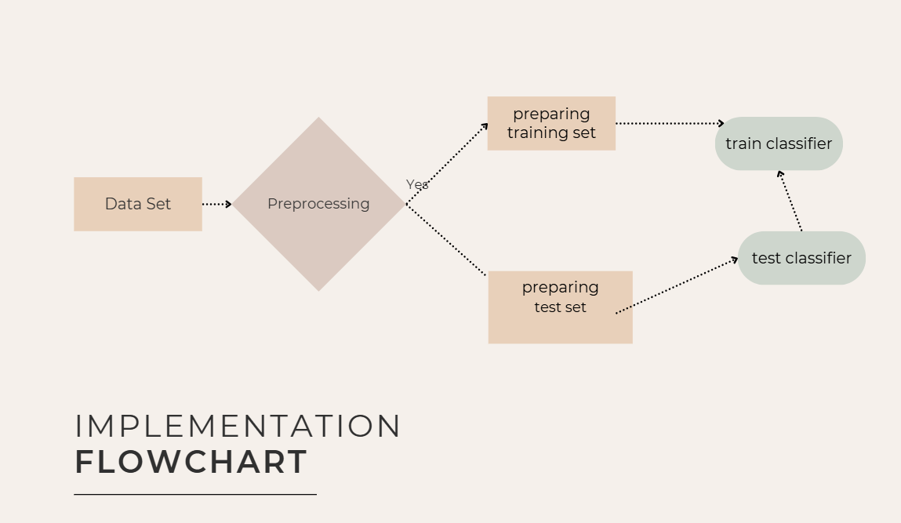

Slide 10

Advantages
A lower cost than traditional methods of getting customer insight.
A faster way of getting insight from customer data.
As 80% of all data in business consists of words, the Sentiment Engine is an essential tool for making sense of it all.
More accurate and insightfull customer perceptions and feedback.

Slide 11
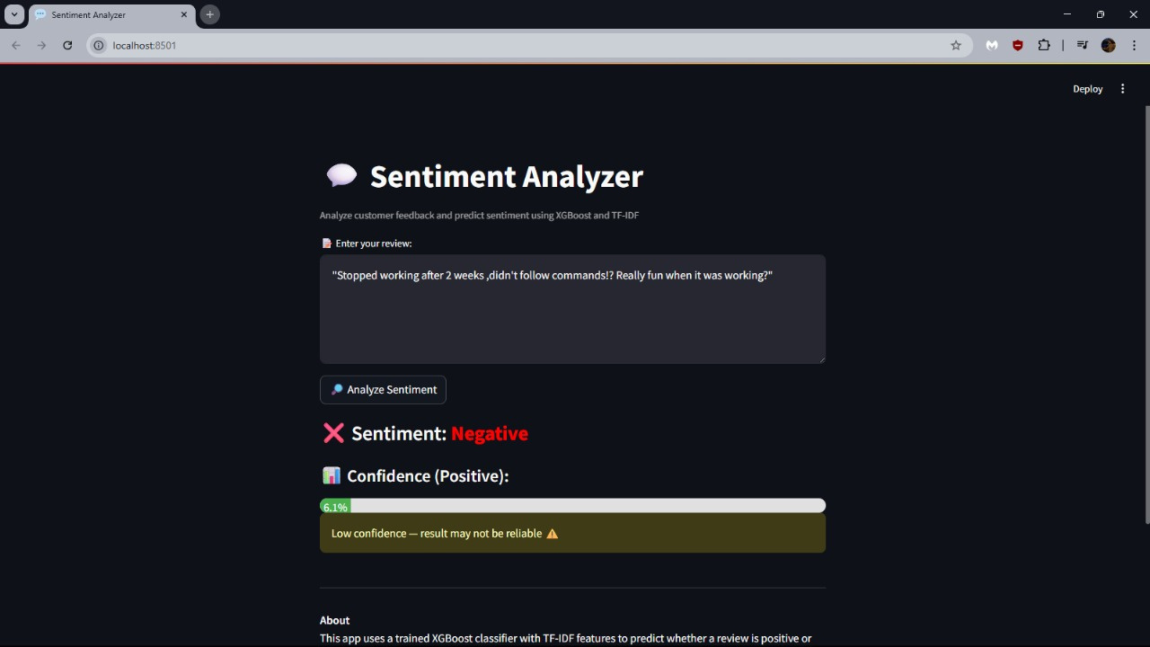
sentimental analysis :Negative

Slide 12
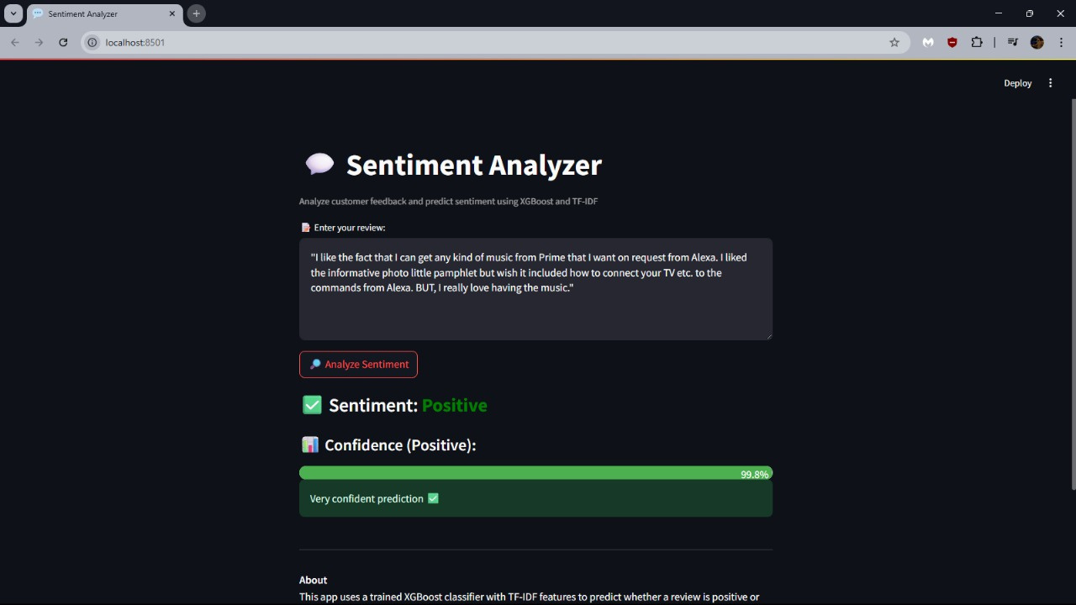
Sentimental analysis :Positive

Slide 13
Thank You
Send it to us! We hope you learned something new.

